Slide 1
The Mainframe DevOps Team Saves the Day
Rich Jackson – Principal Systems Engineer – Walmart
Rosalind Radclifffe – Distinguished Engineer - IBM
DevOps Enterprise Summit – San Francisco, CA – Nov. 9, 2016

Slide 2
Who is Walmart
Key Facts
Established in 1962
2.3 million associates
Serving 260 million customers a week
11,500+ retail units under 63 banners in 28 countries
eCommerce sites in 11 countries
$482+ billion in sales

Slide 3

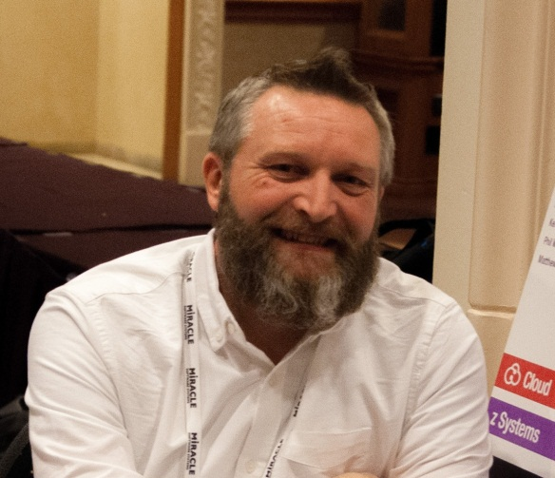
Who we are
Rich Jackson
Principal Systems Engineer at Walmart Technology
Rosalind Radcliffe
Distinguished Engineer and Chief Architect for DevOps at IBM

Slide 4
Background
Inventory Management Innovation
Inventory – it’s a big deal
Small Batches
Out of Stock vs. Carrying Inventory
Retail Link – Share the information
Differentiator – …and a game changer
Overhaul for the 2010s

Slide 5
The Problem
Caching
Web server layer and cache layer
Session State
Appliances – the appeal
Timeline and other solutions
“In the middle of difficulty lies opportunity”

Slide 6
The Solution
Caching Service
Skunkworks project
Minimize Developer burden
Stash and retrieve data… no biggie
Non-functional requirements were the focus
z/OS, CICS, & VSAM
Assembler & COBOL

Slide 7



The Solution
Resistance
Preconceived Notions
If you can break it, don’t use it
Can you handle 100 TPS?
500?, 1000?, 2000?, 4000?
Ugh…. Okaaay

Slide 8

The Results
Success
Successful go-live
Dev team is now a big advocate
Still in production today
~21 Billion requests with no disruption

Slide 9
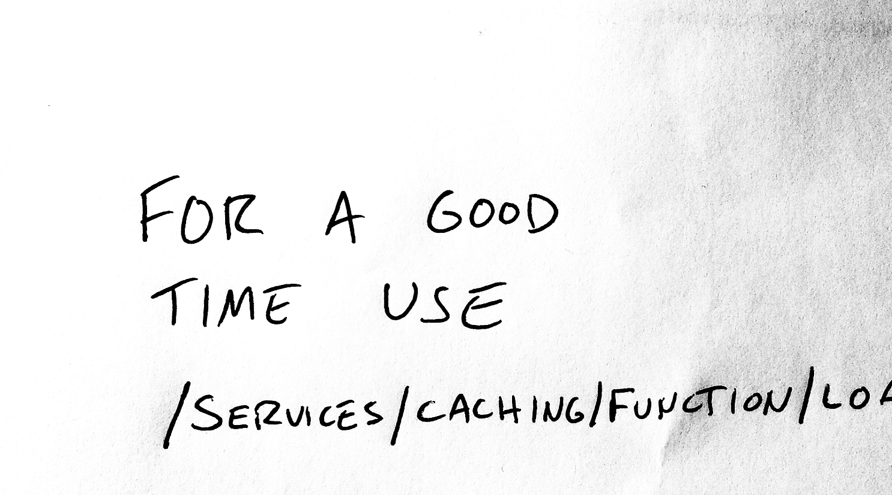
Word of Mouth

Slide 10

More Services
Object Stores
Key/Value object store with rich feature set and array of DBMS-like capabilities
ID Management
Creating web service IDs, reset and resume RACF IDs
Queues
Create new MQ queues and queue remote definitions
InfoSec/Crypto
Various cryptographic functions over HTTP

Slide 11
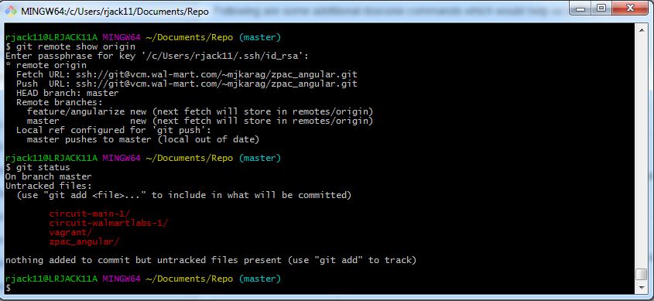
Git Some Services
Enterprise Cache
Key/Value store for transient object caching
FAM
Key/Value object store with rich feature set and array of DBMS-like capabilities
zUID
Unique ID generator over HTTP

Slide 12
Parting Thoughts

Slide 13



